Slide 1
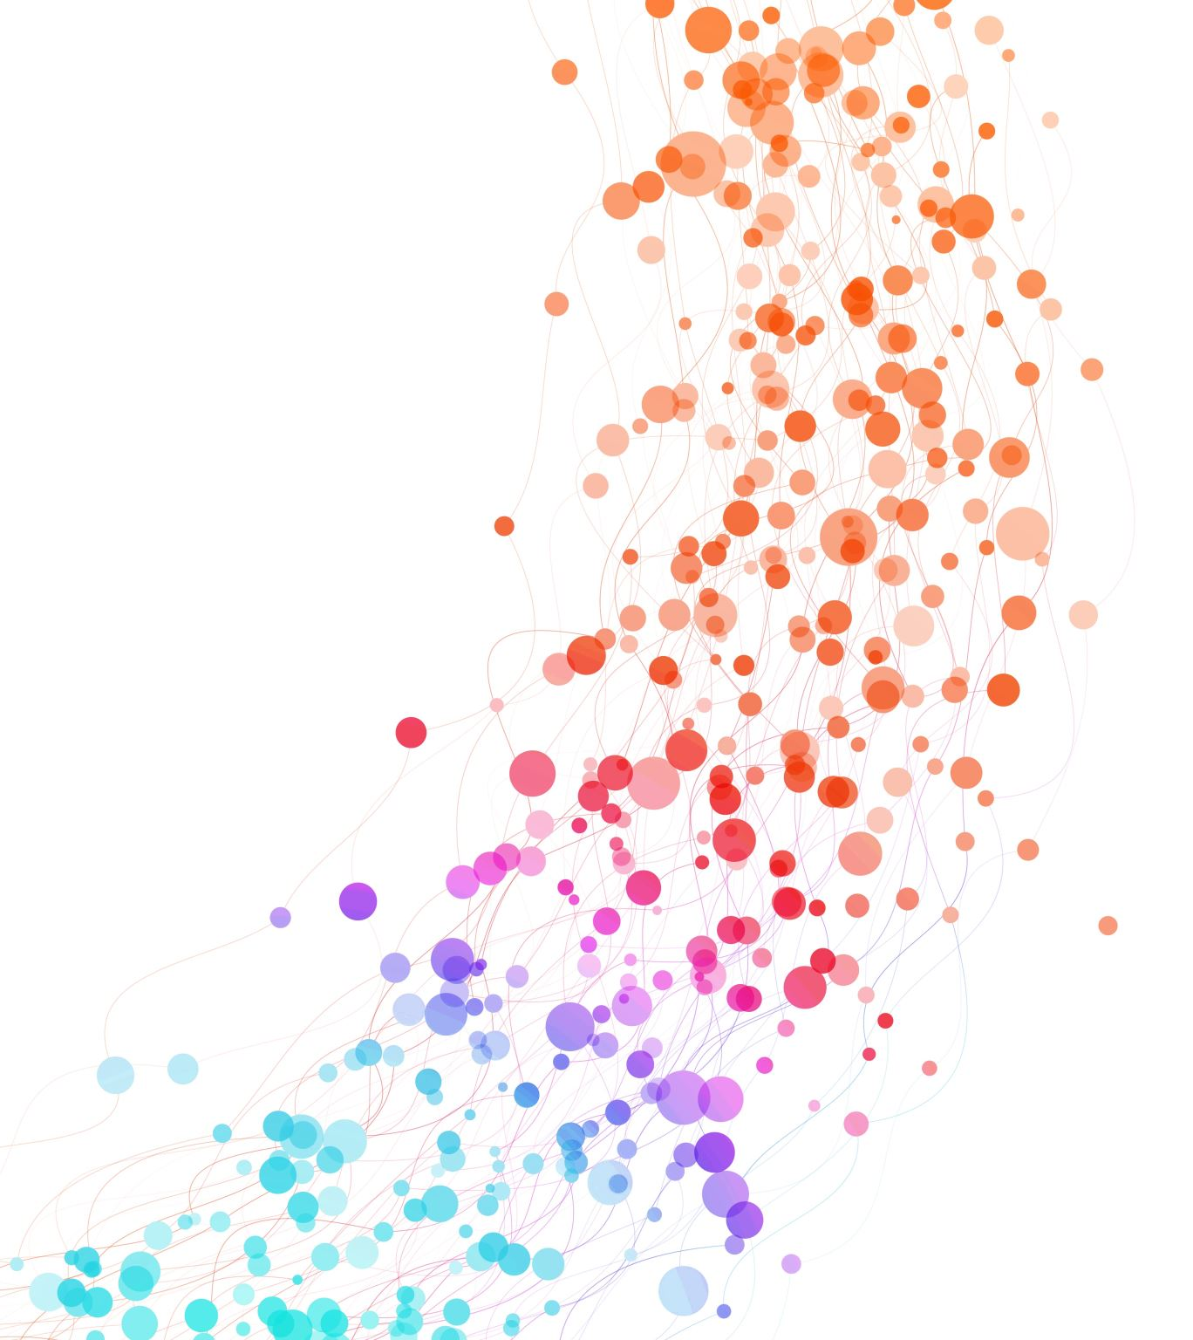
Geospatial Database Using MongoDB
everaging MongoDB for Geospatial Data Management
Atta Muhammad
92333197110

Slide 2
Introduction to Geospatial Databases
Definition: Databases designed to store, query, and manipulate spatial data.
Use Cases:
Location-based services (e.g., Uber, Google Maps)
Environmental monitoring
Urban planning
Why MongoDB?
NoSQL flexibility
Built-in geospatial querying capabilities

Slide 3
MongoDB Geospatial Features
Support for GeoJSON objects:
Point
Line
String
Polygon
Index Types:
2d index
2dsphere index
Geospatial Query Operators:
$geoWithin
$near
$geoIntersects

Slide 4
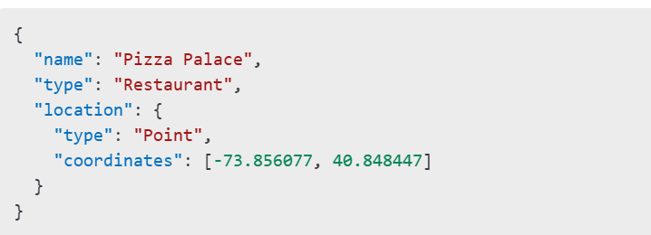
Sample MongoDB Geospatial Dataset

Slide 5

Creating the Sample Database

Slide 6
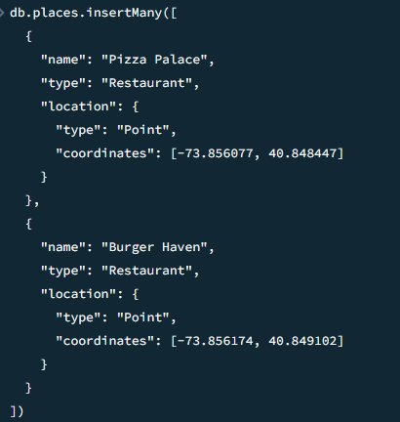
Inserting a sample document

Slide 7
Creating a Geospatial Index

Slide 8
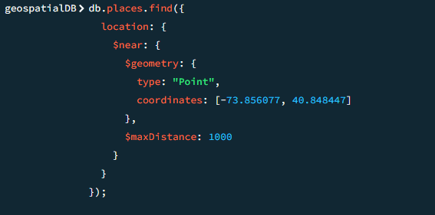
Querying Geospatial Data - $near

Slide 9
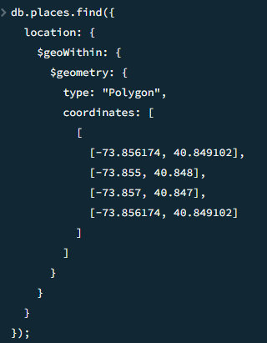
Querying Geospatial Data - $geoWithin

Slide 10
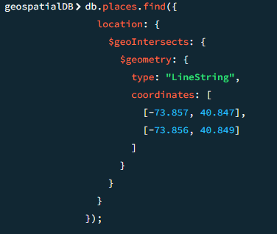
Querying Geospatial Data - $geoIntersects
Find places intersecting a specific geometry (e.g., a road).

Slide 11
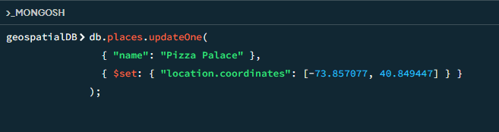
Updating Geospatial Data

Slide 12
Real-World Applications
Logistics: Optimize delivery routes.
Real Estate: Identify properties in specific areas.
Emergency Services: Locate nearest hospitals or police stations.

Slide 13
Advantages of Using MongoDB for Geospatial Data
Flexible schema design.
Scalable and distributed architecture.
Built-in support for geospatial data and queries.

Slide 14
Quetions

